Slide 1

Data Storages & Permissions
Maxim Leykin (maxim.leykin@gmail.com)

Slide 2
Permissions

Slide 3

Android Permissions Model
Beginning Android 6.0 (API level 23), users grant permissions to apps while the app is running, not when they install the app.
System Permissions
Normal permissions do not directly risk the user's privacy. If your app lists a normal permission in its manifest, the system grants the permission automatically.
Dangerous permissions can give the app access to the user's confidential data. If your app lists a normal permission in its manifest, the system grants the permission automatically. If you list a dangerous permission, the user has to explicitly give approval to your app.
If the device is running Android 5.1 or lower, or your app's target SDK is 22 or lower: If you list a dangerous permission in manifest, the user has to grant the permission when they install the app; if they do not grant the permission, the system does not install the app at all.
If the device is running Android 6.0 or higher, and your app's target SDK is 23 or higher: The app has to list the permissions in the manifest, and it must request each dangerous permission it needs while the app is running. The user can grant or deny each permission, and the app can continue to run with limited capabilities even if the user denies a permission request. Users can revoke permissions from any app at any time, even if the app targets a lower API level. You should test your app to verify that it behaves properly when it's missing a needed permission, regardless of what API level your app targets.

Slide 4
Check for Permissions
If the app has the permission, the method returns PackageManager.PERMISSION_GRANTED, and the app can proceed with the operation. If the app does not have the permission, the method returns PERMISSION_DENIED, and the app has to explicitly ask the user for permission.
// Assume thisActivity is the current activity int permissionCheck = ContextCompat.checkSelfPermission(thisActivity, Manifest.permission.WRITE_CALENDAR);

Slide 5
Request the permissions you need
if (ContextCompat.checkSelfPermission(thisActivity, Manifest.permission.READ_CONTACTS)
!= PackageManager.PERMISSION_GRANTED) {
if (ActivityCompat.shouldShowRequestPermissionRationale(thisActivity,
Manifest.permission.READ_CONTACTS)) {
// Show an explanation to the user
} else {
// No explanation needed, we can request the permission.
ActivityCompat.requestPermissions(thisActivity, new String[]{Manifest.permission.READ_CONTACTS},
MY_PERMISSIONS_REQUEST_READ_CONTACTS);
}
}

Slide 6
Request the permissions you need
public void onRequestPermissionsResult(int requestCode, String permissions[], int[] grantResults) {
switch (requestCode) {
case MY_PERMISSIONS_REQUEST_READ_CONTACTS: {
// If request is cancelled, the result arrays are empty.
if (grantResults.length > 0 && grantResults[0] == PackageManager.PERMISSION_GRANTED) {
// permission was granted, yay!
} else {
// permission denied, boo! Disable the functionality that depends on this permission.
}
return;
}
// other 'case' lines to check for other permissions this app might request
}
}

Slide 7
Data Storages

Slide 8
Approaches to Store Data
In Android there are following methods to store data:
Shared preferences - store private primitive data in key-value pairs
Files – arbitrary files
Resources of the application
Internal storage - store private data on the device memory
External storage - store public data on the shared external storage.
SQLite databases - store structured data in a private database.
To access data we can use Content Providers.

Slide 9
Shared Preferences

Slide 10
How to Use Shared Preferences?
The SharedPreferences class provides a general framework that allows you to save and retrieve persistent key-value pairs of primitive data types.
You can use SharedPreferences to save any primitive data: > booleans, floats, ints, longs, and strings.
This data will persist across user sessions (even if your application is killed).
To get a SharedPreferences object for your application, use one of two methods:
getSharedPreferences() - Use this if you need multiple preferences files identified by name, which you specify with the first parameter.
getPreferences() - Use this if you need only one preferences file for your Activity. Because this will be the only preferences file for your Activity, you don't supply a name.
To write values:
Call edit() to get a SharedPreferences.Editor.
Add values with methods such as putBoolean() and putString().
Commit the new values with commit()
To read values:
use SharedPreferences methods such as getBoolean() and getString()

Slide 11
How to Write to Shared Preferences?
protected void savePreferences() {
// Create or retrieve the shared preference object.
public static final String MYPREFS = “mySharedPreferences”;
int mode = Activity.MODE_PRIVATE;
SharedPreferences mySharedPreferences = getSharedPreferences(MYPREFS, mode);
// Retrieve an editor to modify the shared preferences.
SharedPreferences.Editor editor = mySharedPreferences.edit();
// Store new primitive types in the shared preferences object.
editor.putBoolean(“isTrue”, true);
editor.putFloat(“lastFloat”, 1f);
editor.putInt(“wholeNumber”, 2);
editor.putLong(“aNumber”, 3l);
editor.putString(“textEntryValue”, “Not Empty”);
// Commit the changes.
editor.commit();
}

Slide 12
How to Read from Shared Preferences?
public void loadPreferences() {
// Get the stored preferences
public static final String MYPREFS = “mySharedPreferences”;
int mode = Activity.MODE_PRIVATE;
SharedPreferences mySharedPreferences = getSharedPreferences(MYPREFS, mode);
// Retrieve the saved values.
boolean isTrue = mySharedPreferences.getBoolean(“isTrue”, false);
float lastFloat = mySharedPreferences.getFloat(“lastFloat”, 0f);
int wholeNumber = mySharedPreferences.getInt(“wholeNumber”, 1);
long aNumber = mySharedPreferences.getLong(“aNumber”, 0);
String stringPreference;
stringPreference = mySharedPreferences.getString(“textEntryValue”,“”);
}

Slide 13
Activity Specific Shared Preferences
protected void saveActivityPreferences() {
// Create or retrieve the activity preferences object.
SharedPreferences activityPreferences = getPreferences(Activity.MODE_PRIVATE);
// Retrieve an editor to modify the shared preferences.
SharedPreferences.Editor editor = activityPreferences.edit();
// Retrieve the View
TextView myTextView = (TextView)findViewById(R.id.myTextView);
// Store new primitive types in the shared preferences object.
editor.putString(“currentTextValue”,
myTextView.getText().toString());
// Commit changes.
editor.commit();
}
Sample: SharedPrefs

Slide 14
Files in Application

Slide 15
Files in Resources
Static files are stored in /res/raw folder
Since raw is a subfolder of Resources (res), Android will automatically generate an ID for any file located inside it. This ID is then stored an the R class that will act as a reference to a file, meaning it can be easily accessed from other Android classes and methods and even in Android XML files. Using the automatically generated ID is the fastest way to have access to a file in Android.
Accessible from code via method Resources getResources()
Readable as InputStream:
InputStream in=getResources().openRawResource(R.raw.words);
Not writable!
Sample: RawResources

Slide 16
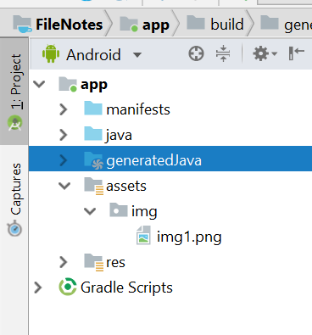
Files in Assets
The /assets folder is an “appendix” directory. The R class does not generate IDs for the files placed there, so its less compatible with some Android classes and methods. Also, it’s much slower to access a file inside it, since you will need to get a handle to it based on a String. You can navigate this directory in the same way as a typical file system using URIs and read files as a stream of bytes using the AssetManager . For example, this is a good location for file hierarchy, textures and game data.
AssetManager assetManager = getAssets();
InputStream is = assetManager.open("img/img1.png");
Bitmap bitmap = BitmapFactory.decodeStream(is);
imageView.setImageBitmap(bitmap);

Slide 17
Files in Internal/External Storages

Slide 18
Internal vs External storages
Internal Storage | External Storage
It's always available. Files saved here are accessible by only your app. When the user uninstalls your app, the system removes all your app's files from internal storage. Internal storage is best when you want to be sure that neither the user nor other apps can access your files. | It's not always available, because the user can mount the external storage as USB storage and in some cases remove it from the device. It's world-readable, so files saved here may be read outside of your control. When the user uninstalls your app, the system removes your app's files from here only if you save them in the directory from getExternalFilesDir(). External storage is the best place for files that don't require access restrictions and for files that you want to share with other apps or allow the user to access with a computer.
Internal storage:
External storage:

Slide 19
Files in Internal Storage
You can save files directly on the device's internal storage.
By default, files saved to the internal storage are private to your application and other applications cannot access them
When the user uninstalls your application, these files are removed

Slide 20
Files in Internal Storage
To create and write a private file to the internal storage:
Call openFileOutput() with the name of the file and the operating mode. This returns a FileOutputStream object
Write to the file with write()
Close the stream with close()
To read a file from internal storage:
Call openFileInput() and pass it the name of the file to read. This returns a FileInputStream.
Read bytes from the file with read()
Then close the stream with close()
String FILENAME = "hello_file";
String string = "hello world!";
FileOutputStream fos = openFileOutput(FILENAME, Context.MODE_PRIVATE);
fos.write(string.getBytes());
fos.close();
String FILENAME = "hello_file";
FileInputStream fis = openFileInput(FILENAME, Context.MODE_PRIVATE);
int n = fis.read();
fis.close();

Slide 21
Useful Methods
getFilesDir()
Gets the absolute path to the filesystem directory where your internal files are saved.
getDir()
Creates (or opens an existing) directory within your internal storage space.
deleteFile()
Deletes a file saved on the internal storage.
fileList()
Returns an array of files currently saved by your application.
getCacheDir()
Returns a File representing the cache directory on the file system that's uniquely associated with your app. This directory is meant for temporary files, and it should be cleaned up regularly. The system may delete files there if it runs low on disk space, so make sure you check for the existence of your cache files before reading them.

Slide 22
Using External Storage
You can save two different types of files in external storage:
Public files: Files that should be freely available to other apps and to the user. When the user uninstalls your app, these files should remain available to the user. For example, photos captured by your app or other downloaded files should be saved as public files.
Private files: Files that rightfully belong to your app and will be deleted when the user uninstalls your app. Although these files are technically accessible by the user and other apps because they are on the external storage, they don't provide value to the user outside of your app.

Slide 23
Requesting Read/Write Permissions
To write to the public external storage, you must request the WRITE_EXTERNAL_STORAGE permission in your manifest file and in runtime when your app attempts to perform actual write operation.
<manifest ...>
<uses-permission android:name="android.permission.WRITE_EXTERNAL_STORAGE" />
...
</manifest>
If your app only needs to read the external storage (but not write to it), then you need to declare (and request in runtime) the READ_EXTERNAL_STORAGE permission
<manifest ...>
<uses-permission android:name="android.permission.READ_EXTERNAL_STORAGE" />
...
</manifest>

Slide 24
Checking Media Availability
Before you do any work with the external storage, you should always call getExternalStorageState() to check the state of the media
Mounted
Missing
Read-only
Some other state
boolean mExternalStorageAvailable = false;
boolean mExternalStorageWriteable = false;
String state = Environment.getExternalStorageState();
if (Environment.MEDIA_MOUNTED.equals(state)) {
// We can read and write the media
mExternalStorageAvailable = mExternalStorageWriteable = true;
} else if (Environment.MEDIA_MOUNTED_READ_ONLY.equals(state)) {
// We can only read the media
mExternalStorageAvailable = true;
mExternalStorageWriteable = false;
} else {
// Something else is wrong. It may be one of many other states, //but all we need to know is we can neither read nor write
mExternalStorageAvailable = mExternalStorageWriteable = false;
}

Slide 25
Saving to a private directory
Use getExternalFilesDir() to open a File that represents the external storage directory where
you should save your files
This method takes a type parameter that specifies the type of subdirectory you want, such as DIRECTORY_MUSIC and DIRECTORY_RINGTONES
This method will create the appropriate directory if necessary.
By specifying the type of directory, you ensure that the Android's media scanner will properly categorize your files in the system (for example, ringtones are identified as ringtones and not music).
If the user uninstalls your application, this directory and all its contents will be deleted.
public File getPrivateAlbumStorageDir(Context context, String albumName) {
// Get the directory for the app's private pictures directory.
File file = new File(context.getExternalFilesDir(Environment.DIRECTORY_PICTURES), albumName);
if (!file.mkdirs()) {
Log.e(LOG_TAG, "Directory not created");
}
return file;
}

Slide 26
Saving to a public directory
If you want to save files that are not specific to your application and that should not be deleted when your application is uninstalled, save them to one of the public directories on the external storage.
These directories lay at the root of the external storage, such as Music/, Pictures/, Ringtones/, and others
Use getExternalStoragePublicDirectory(), passing it the type of public directory you want, such as DIRECTORY_MUSIC, DIRECTORY_PICTURES, DIRECTORY_RINGTONES, or others
This method will create the appropriate directory if necessary
Sample: FIleNotes
public File getPublicAlbumStorageDir(String albumName) {
// Get the directory for the user's public pictures directory.
File file = new File(Environment.getExternalStoragePublicDirectory(
Environment.DIRECTORY_PICTURES), albumName);
if (!file.mkdirs()) {
Log.e(LOG_TAG, "Directory not created");
}
return file;
}

Slide 27
SQLite Databases

Slide 28
SQLite Databases
SQLite is a software library that implements a selfcontained, serverless, zero-configuration, transactional SQL database engine.
Android provides full support for SQLite databases.
Database is private to the application that creates it: i.e. any databases you create will be accessible to any class in the application, but not outside the application.
All databases are stored in /data/data/ <package_name>/databases folder on your device

Slide 29
Creating and upgrading databases
The recommended method to create a new SQLite database is to create a subclass of SQLiteOpenHelper and override the onCreate() and onUpgrade() methods, in which you can execute a SQLite command to create/upgrade tables in the database. Class SQLiteOpenHelper wraps best practice pattern for creating, opening and upgrading databases. Then use execSQL() for executing SQL
public class MyDbOpenHelper extends SQLiteOpenHelper {
private static final int DATABASE_VERSION = 2;
private static final String DICTIONARY_TABLE_NAME = "dictionary";
private static final String DICTIONARY_TABLE_CREATE =
"CREATE TABLE " + DICTIONARY_TABLE_NAME + " (" +
KEY_WORD + " TEXT, " +
KEY_DEFINITION + " TEXT);";
DictionaryOpenHelper(Context context) {
super(context, DATABASE_NAME, null, DATABASE_VERSION);
}
@Override
public void onCreate(SQLiteDatabase db) {
db.execSQL(DICTIONARY_TABLE_CREATE);
}
}

Slide 30
Database scheme
To create DB scheme (implementation of BaseColumns provides automatic addition of primary key):
import android.provider.BaseColumns;
public class DBScheme {
public static abstract class Vendors implements BaseColumns {
public static final String TABLE_NAME = "vendors";
public static final String COLUMN_NAME_ID = "vendor_id";
public static final String COLUMN_NAME_TITLE = "vendor_name";
public static final String COLUMN_NAME_COUNTRY = "vendor_country";
}
public static abstract class Models implements BaseColumns {
public static final String TABLE_NAME = "models";
public static final String COLUMN_NAME_ID = "model_id";
public static final String COLUMN_NAME_TUTLE = "model_name";
public static final String COLUMN_NAME_VENDOR_ID = "vendor_id";
}
}

Slide 31
Create tables and indices
private static final String TEXT_TYPE = " TEXT";
private static final String COMMA_SEP = ",";
private static final String SQL_CREATE_VENDORS =
"CREATE TABLE " + DBScheme.Vendors.TABLE_NAME + " (" +
DBScheme.Vendors._ID + " INTEGER PRIMARY KEY," +
DBScheme.Vendors.COLUMN_NAME_ID + TEXT_TYPE + COMMA_SEP +
DBScheme.Vendors.COLUMN_NAME_TITLE + TEXT_TYPE + COMMA_SEP +
DBScheme.Vendors.COLUMN_NAME_COUNTRY + TEXT_TYPE + COMMA_SEP + " )";
db.execSQL(SQL_CREATE_VENDORS );
db.execSQL("CREATE INDEX vendorsByNameIdx “+ "ON vendors (vendor_name)");

Slide 32
Insert data into DB
Option #1 (if queries are static)
db.execSQL("INSERT INTO vendors (name, country)"+
"VALUES (‘Samsung', South Korea)");
Option #2 (if queries are dynamic)
ContentValues values = new ContentValues();
values.put(DBScheme.Vendors.COLUMN_NAME_TITLE, “Samsung”);
values.put(DBScheme.Vendors.COLUMN_NAME_COUNTRY, “South Korea”);
long newRowId;
newRowId = db.insert( DBScheme.Vendors.TABLE_NAME, null, values);

Slide 33
Read data from DB
Option #1 (static queries):
String[ ] parms={“Samsung"};
Cursor result = db.rawQuery ("SELECT name, country FROM vendors WHERE name=?“, parms);
Option #2 (runtime queries)
String[ ] columns={“name“, “country”};
String[ ] parms={“Samsung"};
Cursor result=db.query(“vendors", columns, "name=?“, parms, null, null, null);
Last 3 parameters are: group by, having by, order by соответственно

Slide 34
How to work with Cursor
Cursor result= db.rawQuery("SELECT id, name, country FROM vendors");
result.moveToFirst();
while (!result.isAfterLast()) {
int id=result.getInt(0);
String name=result.getString(1);
String country=result.getString(2);
// do something useful with these
result.next();
}
result.close();
Important! Don’t forget to close cursor when it is no longer needed
Sample: AndroidDBSample

Slide 35
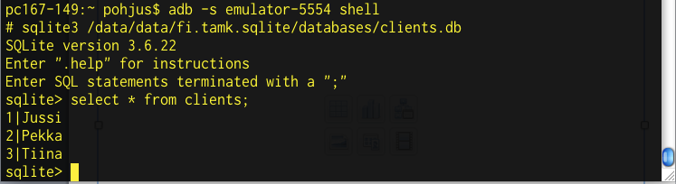
Command line tool
Android SDK has a tool called sqlite3 which enables you to browse table contents using sql commands and command line

Slide 36
Content Providers

Slide 37
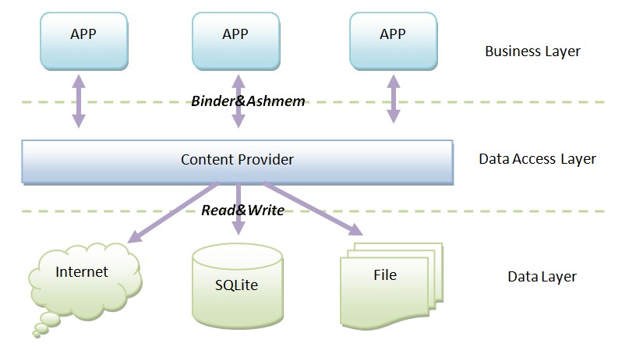
Content Providers
Content providers can help an application manage access to data stored by itself, stored by other apps, and provide a way to share data with other apps. They encapsulate the data, and provide mechanisms for defining data security. Content providers are the standard interface that connects data in one process with code running in another process.
Generic interface for data
Permission control and accessing using URI model
Native databases available as Content Providers
Publishing your own data source, other apps can incorporate your database

Slide 38
Content Resolver
Application context has Content Resolver which you can use to access data:
ContentResolver cr = getContentResolver();
• For accessing other databases, you need a URI
• URI is arbitrary String, which is defined in manifest file
// Query
Cursor c = getContentResolver().query(URI, ..., ... ,...);
// Insert
getContentResolver().insert(URI, newValues);
// Delete
getContentResolver().delete(URIofTheRow, ...);

Slide 39
URIs
Content URIs must be unique between providers.
• Use your package name
• General form
content://com.<company>.provider.<app>/<data>
• Example for querying all items
content://fi.pohjolainen_jussi.provider.myapp/items
• Example for querying single item
content://fi.pohjolainen_jussi.provider.myapp/items/5

Slide 40
Get Data via Content Resolver
Data query via ContentResolver is performed by method query().
public final Cursor query (Uri uri, String[ ] projection, String selection, String[ ] selectionArgs, String sortOrder)
Arguments:
uri – content URI
projection – columns we want to get
selection – where clause with ? as parameter placeholders
selectionArgs – args for where clause
sortOrder – ordering and grouping
// Return all rows
Cursor allRows = getContentResolver().query(MyProvider.CONTENT_URI,
null, null, null, null);
// Return all columns for rows where column 3 equals
//a set value and the rows are ordered by column 5.
String where = KEY_COL3 + “=” + requiredValue;
String order = KEY_COL5;
Cursor someRows = getContentResolver().query(MyProvider.CONTENT_URI,
null, where, null, order);

Slide 41
Insert Data via Content Resolver
Option #1
// Create a new row of values to insert.
ContentValues newValues = new ContentValues();
// Assign values for each row.
newValues.put(COLUMN_NAME, newValue);
…
getContentResolver().insert(MyProvider.CONTENT_URI,
newValues);
Option #2
// Create a new row of values to insert.
ContentValues[] valueArray = new ContentValues[5];
// TODO: Create an array of new rows
int count = getContentResolver().bulkInsert(MyProvider.CONTENT_URI,
valueArray);

Slide 42
Delete and Update Data via Content Resolver
// Remove a specific row.
getContentResolver().delete(myRowUri, null, null);
// Remove the first five rows.
String where = “_id < 5”;
getContentResolver().delete(MyProvider.CONTENT_URI, where, null);
// Create a new row of values to insert.
ContentValues newValues = new ContentValues();
// Create a replacement map, specifying which columns you want to
// update, and what values to assign to each of them.
newValues.put(COLUMN_NAME, newValue);
// Apply to the first 5 rows.
String where = “_id < 5”;
getContentResolver().update(MyProvider.CONTENT_URI, newValues, where, null);

Slide 43
Work with Files via Content Provider
Files are retrieved via URI
try {
// Open an output stream using the new row’s URI.
OutputStream outStream = getContentResolver().openOutputStream(uri);
// Compress your bitmap and save it into your provider.
sourceBitmap.compress(Bitmap.CompressFormat.JPEG, 50, outStream);
}
catch (FileNotFoundException e) { }

Slide 44
Platform Native Content Providers
Browser – access to bookmarks, browser history, web searches.
Calendar – access to calendar and events
CallLog – access to call history
Contacts – access to contacts
MediaStore – access to media
Settings – access to settings
Attention! You need to ask for permissions in order to work with native providers. E.g. for contacts:
<uses-permission android:name="android.permission.READ_CONTACTS" />

Slide 45
Platform Native Content Providers
Uri allCalls = Uri.parse("content://call_log/calls");
Cursor c = managedQuery(allCalls, null, null, null, null);
while (c.moveToNext()) {
String num = c.getString(c.getColumnIndex(CallLog.Calls.NUMBER));// for number
String name = c.getString(c.getColumnIndex(CallLog.Calls.CACHED_NAME));// for name
String duration = c.getString(c.getColumnIndex(CallLog.Calls.DURATION));// for duration
int type = Integer.parseInt(c.getString(c.getColumnIndex(CallLog.Calls.TYPE)));// for call type, Incoming or out going.
Toast.makeText(getApplicationContext(), num + name + duration + type, Toast.LENGTH_SHORT).show();
}
Sample: CallLogSample

Slide 46
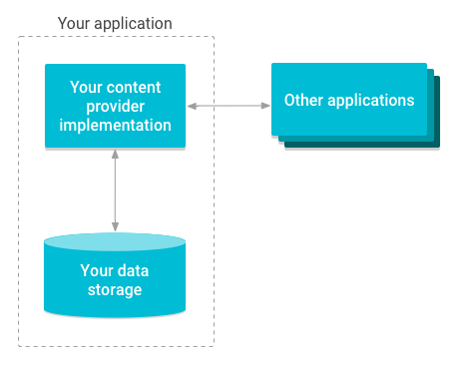
Create Custom Content Provider
This involves number of simple steps to create your own content provider.
First of all you need to create a Content Provider class that extends the ContentProvider base class.
Second, you need to define your content provider URI address which will be used to access the content.
Next you will need to create your own database to keep the content. Usually, Android uses SQLite database and framework needs to override onCreate() method which will use SQLite Open Helper method to create or open the provider's database. When your application is launched, the onCreate() handler of each of its Content Providers is called on the main application thread.
Next you will have to implement Content Provider queries to perform different database specific operations:
query() This method receives a request from a client. The result is returned as a Cursor object.
insert()This method inserts a new record into the content provider.
delete() This method deletes an existing record from the content provider.
update() This method updates an existing record from the content provider.
getType() This method returns the MIME type of the data at the given URI.
Finally register your Content Provider in your activity file using <provider> tag.

Slide 47
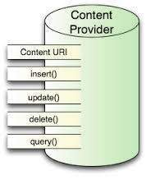
Custom Content Provider - methods
public class MyProvider extends ContentProvider {
public boolean onCreate() { }
public String getType(Uri url) { }
public Cursor query(Uri url, String[] projection, String selection,
String[] selectionArgs, String sort) { }
public Uri insert(Uri _url, ContentValues _initialValues) { }
public int delete(Uri url, String where, String[] whereArgs) { }
public int update(Uri url, ContentValues values, String where, String[] wArgs) { }
}

Slide 48
Custom Content Provider – static members
public class MyProvider extends ContentProvider {
private static final String myURI = “content://com.paad.provider.myapp/items”;
public static final Uri CONTENT_URI = Uri.parse(myURI);
public boolean onCreate() {
// TODO: Construct the underlying database.
return true;
}
// Create the constants used to differentiate between the different URI requests.
private static final int ALLROWS = 1;
private static final int SINGLE_ROW = 2;
private static final UriMatcher uriMatcher;
static {
uriMatcher = new UriMatcher(UriMatcher.NO_MATCH);
uriMatcher.addURI(“com.paad.provider.myApp”, “items”, ALLROWS);
uriMatcher.addURI(“com.paad.provider.myApp”, “items/#”, SINGLE_ROW);
}
}

Slide 49
Custom Content Provider – query()
@Override
public Cursor query(Uri uri, String[] projection, String selection, String[] selectionArgs, String sort) {
// If this is a row query, limit the result set to the passed in row.
switch (uriMatcher.match(uri)) {
case SINGLE_ROW :
// TODO: Modify selection based on row id, where:
// rowNumber = uri.getPathSegments().get(1));
}
return null;
}

Slide 50
Custom Content Provider – insert()
@Override
public Uri insert(Uri _uri, ContentValues _initialValues) {
long rowID = [ ... Add a new item ... ]
// Return a URI to the newly added item.
if (rowID > 0) {
return ContentUris.withAppendedId(CONTENT_URI, rowID);
}
throw new SQLException(“Failed to add new item into “ + _uri);
}

Slide 51
Custom Content Provider – delete()
@Override
public int delete(Uri uri, String where, String[] whereArgs) {
switch (uriMatcher.match(uri)) {
case ALLROWS:
case SINGLE_ROW:
default: throw new IllegalArgumentException(“Unsupported URI:” + uri);
}
}

Slide 52
Custom Content Provider – getType()
@Override
public String getType(Uri _uri) {
switch (uriMatcher.match(_uri)) {
case ALLROWS: return “vnd.paad.cursor.dir/myprovidercontent”;
case SINGLE_ROW: return “vnd.paad.cursor.item/myprovidercontent”;
default: throw new IllegalArgumentException(“Unsupported URI: “ + _uri);
}
}

Slide 53
Custom Content Provider – register
You need to register your provider in AndroidManifest:
<provider android:name=”MyProvider” android:authorities=”com.paad.provider.myapp”/>
Sample: CProvider

